Slide 1

Predicting All-NBA Team Selection
Matthew Holcomb, Jorah Razumeyko, Darian Lee, Ethan Park

Slide 2
Introduction
Topics
What is the “All-NBA Team?”
Project Goals
Preprocessing

Slide 3
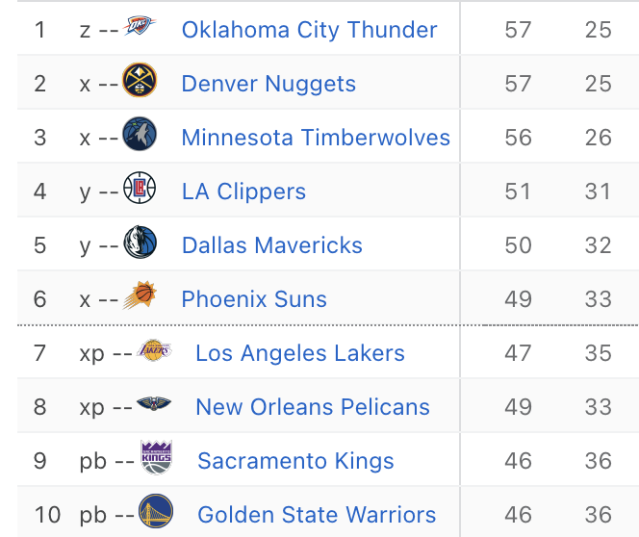
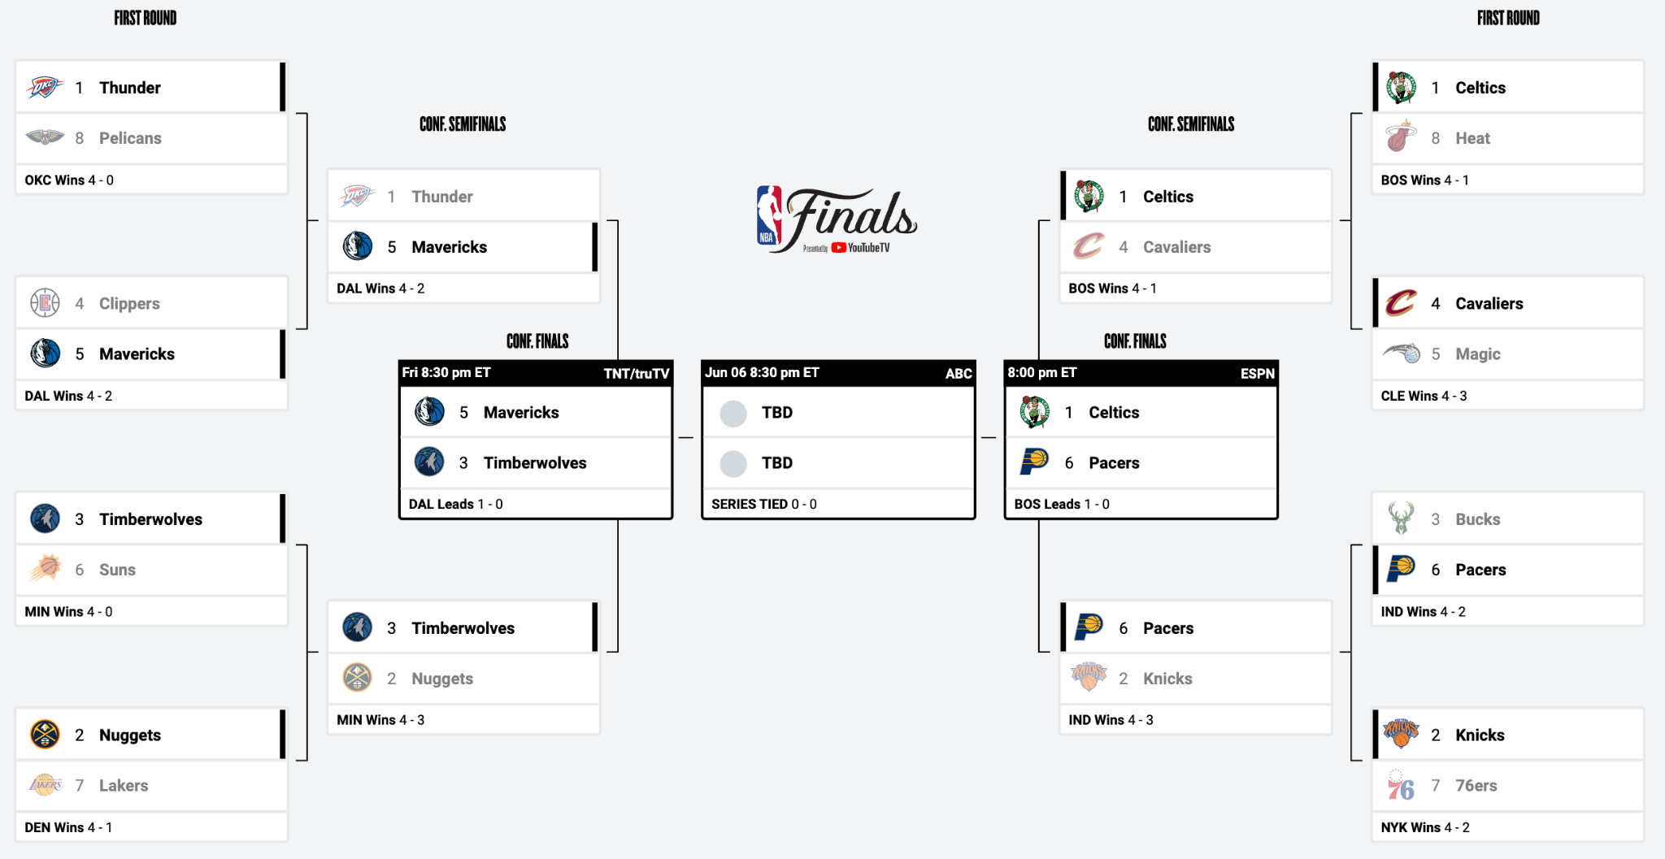
What is the “All-NBA Team?”
The NBA (National Basketball Association) season consists of two parts:
The Regular Season (82 Games)
The Playoffs (Bracketed Tournament)
Image Sources: ESPN.com, NBA.com

Slide 4
What is the “All-NBA Team?”
The All-NBA Team is a Regular Season award, so we will only be focusing on player performance from those games, and ignoring the playoffs.
Image Sources: ESPN.com, NBA.com

Slide 5
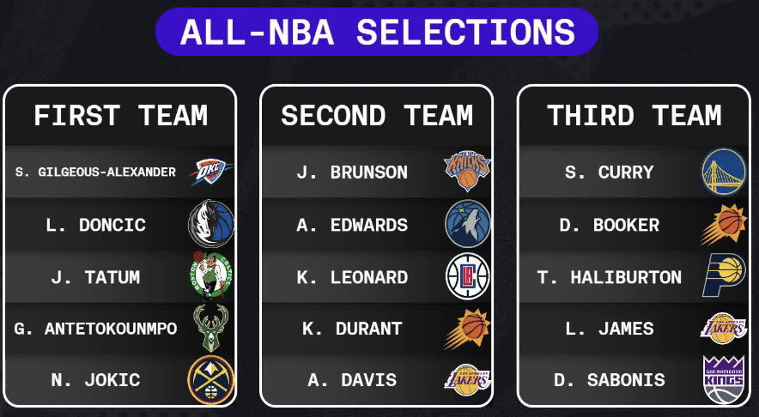
What is the “All-NBA Team?”
The “All-NBA Team” consists of fifteen players chosen through ranked voting by a panel of sportswriters and broadcasters, with the goal of identifying the best players from that year’s regular season.
Image Sources: ESPN.com, BleacherReport.com

Slide 6
Project Goals
While All-NBA selections are certainly based off statistical metrics, there is no set formula which determines who is chosen. Our goals are to:
Create and evaluate models for predicting All-NBA Selections.
Explore how All-NBA Voting has changed over time.
Identify players who were “snubbed” - where our models predict their selection despite not actually making the team.

Slide 7
The Data
Topics
Source
Size
Transformation

Slide 8
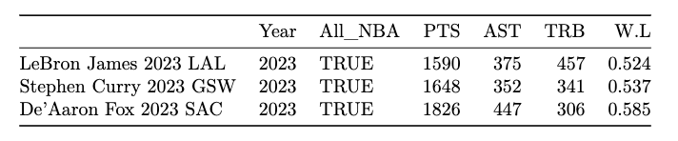
The Data: Source
Regular season player statistics, team winning percentages, and All-NBA voting results from 2004 through 2024 were scraped from Basketball-Reference.com and combined to make up the data set used in this project.
Example Rows with Reduced Columns:

Slide 9
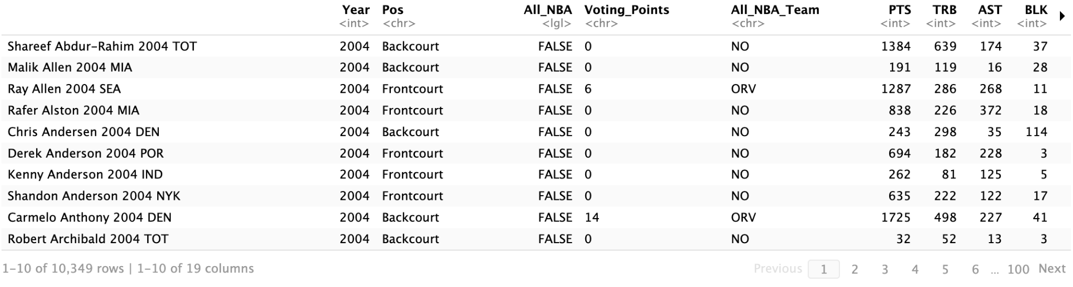
The Data: Size
The data from 2004 through 2024 has:
10,349 rows / observations, each representing a single player for 1 season
19 factors (PTS, AST, TRB, W/L, All-NBA, etc.)
Note: At the time of scraping this data, the All-NBA teams for 2024 had not yet been chosen. As a result, those years are unlabeled with regards to All-NBA.

Slide 10

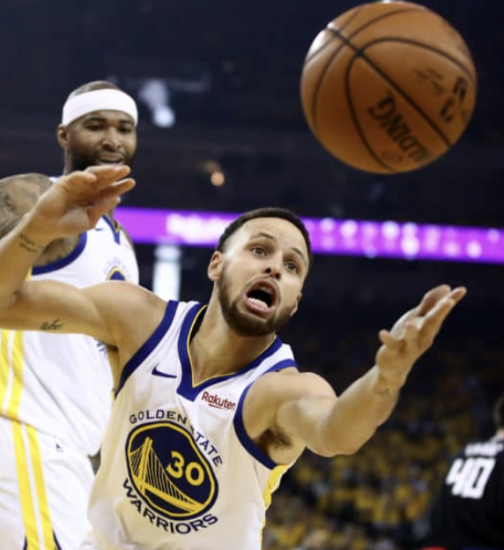
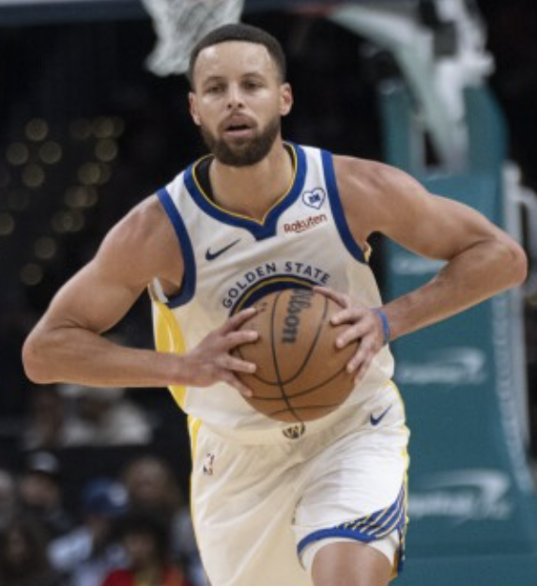
The Data: Initial Observations
So what sets All-NBA players apart from the rest of the league?
Individual performance?
Team performance?
A combination of both?
Points
Rebounds
Assists
Image Sources: BleacherReport.com, NYTimes.com, APNews.com

Slide 11
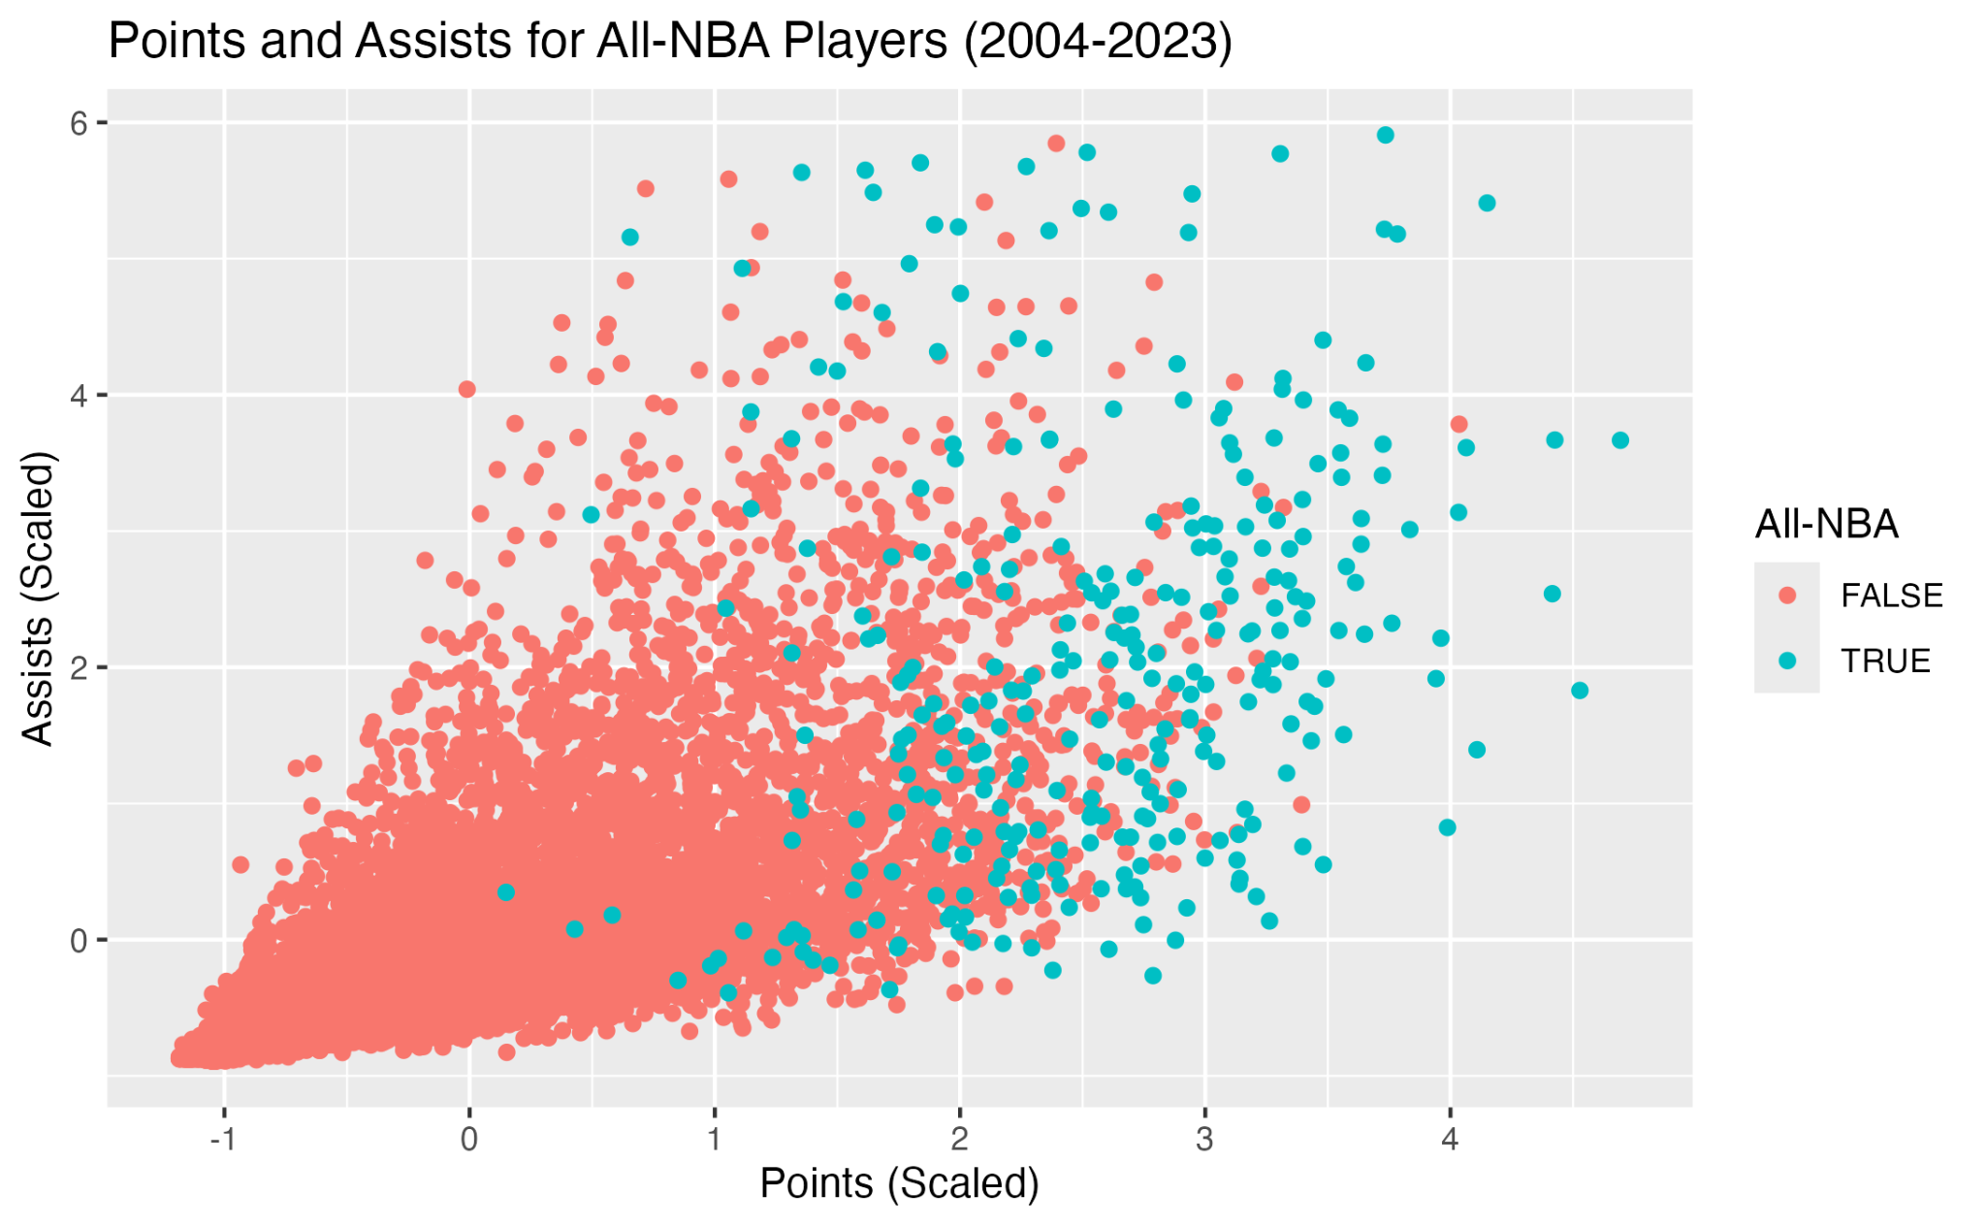
The Data: Initial Observations
While it is certainly reasonable to assume that the “best” players will have the most points and assists, we can see All-NBA is not solely determined by those factors.

Slide 12
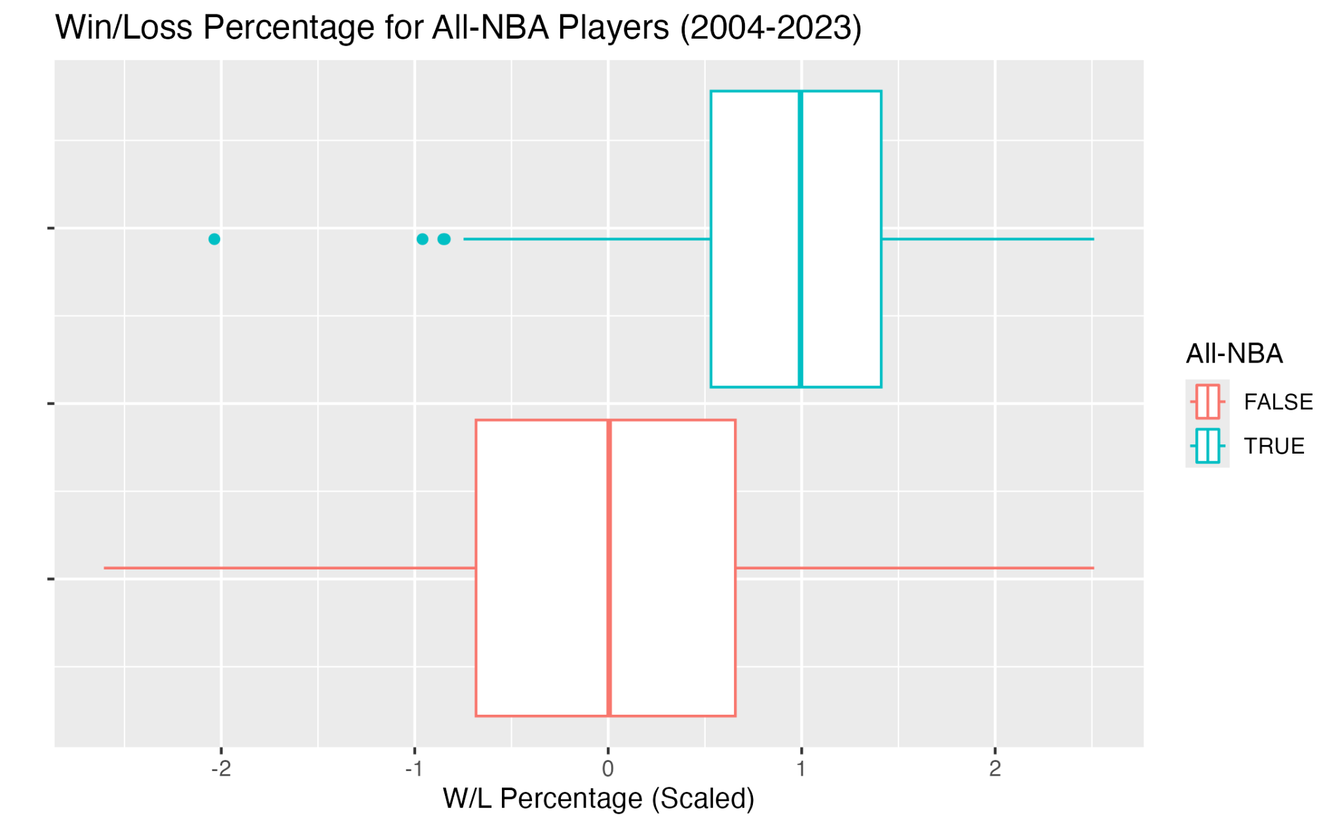
The Data: Initial Observations
Another factor we mentioned is team performance - again, we can see a general pattern in the data, but nothing which specifically separates those who make All-NBA.
Tracy McGrady (ORL, 2004)

Slide 13
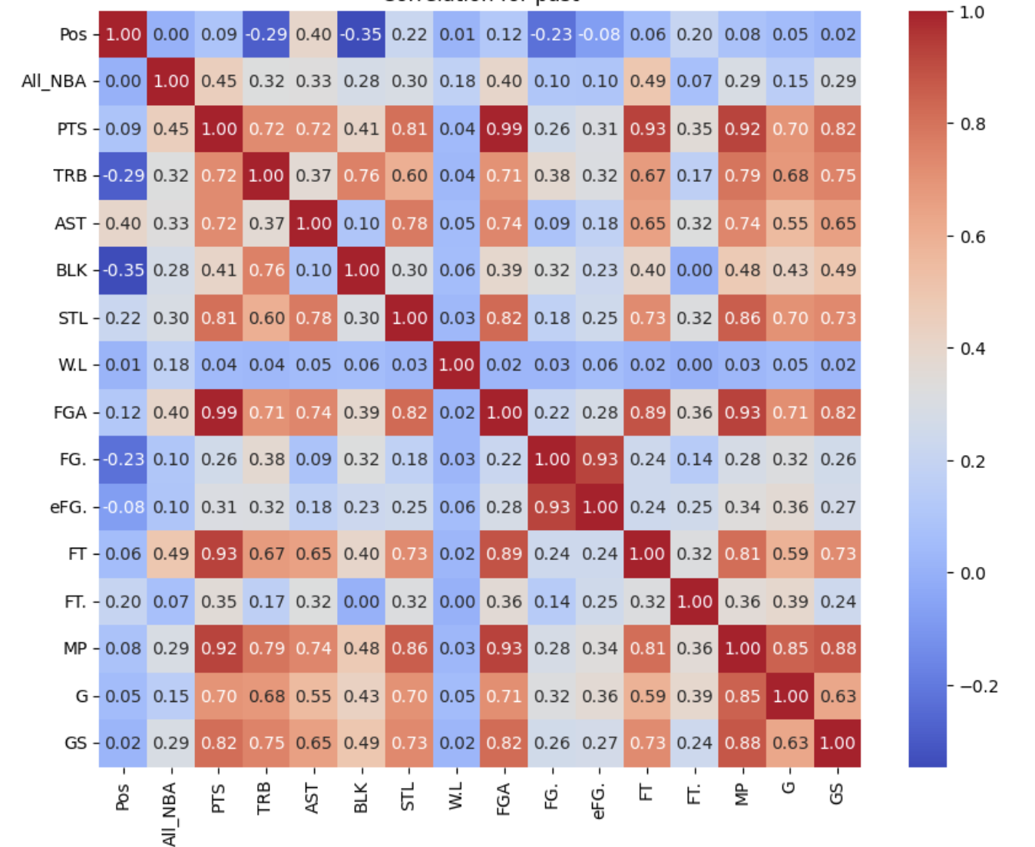
The Data: Initial Observations
Additionally, we looked at the correlation matrix for our factors - especially their relation to All-NBA selection.

Slide 14
The Data: Initial Observations
Additionally, we looked at the correlation matrix for our factors - especially their relation to All-NBA selection.
All factors besides position (Pos) can be seen to have at least some correlation to All-NBA selection.

Slide 15
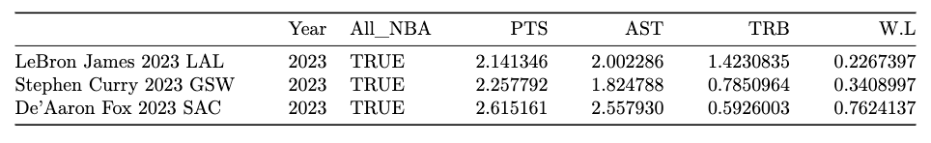
The Data: Transformation
All-NBA selections are based on each player’s performance relative to other players from the same year. In order to compare our metrics across seasons, we chose to normalize our data by year.
Example Rows with Reduced Columns (Scaled):

Slide 16
Methods
Topics
Logistic Regression
Random Forest
Hierarchical Clustering

Slide 17
Goal 1: Predicting All-NBA Using Logistic Regression
The first approach we used to predict All-NBA selections was logistic regression.

Slide 18
Goal 1: Predicting All-NBA Using Logistic Regression
The first approach we used to predict All-NBA selections was logistic regression.
To evaluate the performance of logistic regression, we used a modified version of cross-validation.

Slide 19
Goal 1: Predicting All-NBA Using Logistic Regression
The first approach we used to predict All-NBA selections was logistic regression.
To evaluate the performance of logistic regression, we used a modified version of cross-validation.
For each season from 2012 through 2023, logistic regression models were fit using backward stepwise selection on training data which consisted of the most recent seasons.

Slide 20
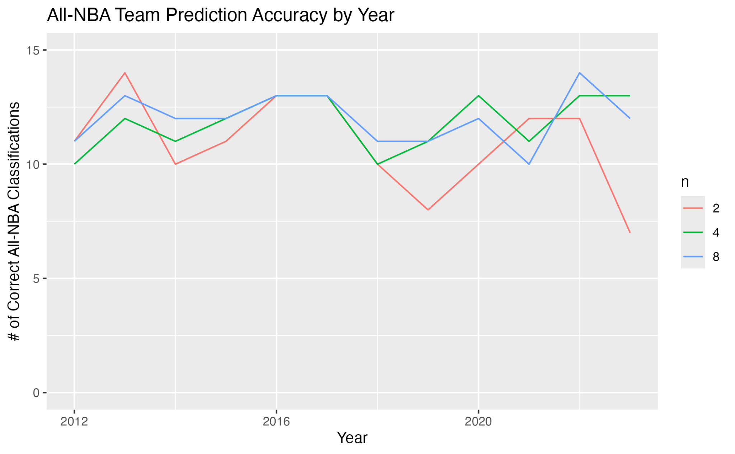
Logistic Regression | Results
Using only the previous 2 seasons seemed to lead to worse predictions than using the previous 4 or 8.
Note: n is The number of previous seasons used for training.

Slide 21
Logistic Regression | Results
Using only the previous 2 seasons seemed to lead to worse predictions than using the previous 4 or 8.
The two best models each predicted ~12/15 players correctly for All-NBA
(>99% accuracy out of 500+ players per season)
Note: n is The number of previous seasons used for training.

Slide 22
Logistic Regression | Results
Our findings suggested that for logistic regression, training on the previous 4 seasons using backward-stepwise selection proved to be an effective way to predict All-NBA selections.

Slide 23
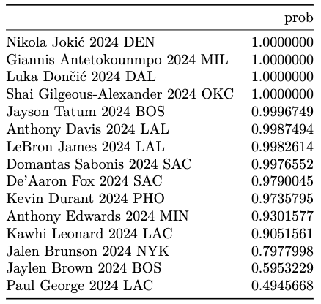
Logistic Regression | Results
Our findings suggested that for logistic regression, training on the previous 4 seasons using backward-stepwise selection proved to be an effective way to predict All-NBA selections.
Our predictions using this method for the 2024 selections can be seen to the right:

Slide 24
Logistic Regression | Results
The model missed three players: Stephen Curry (0.06), Tyrese Haliburton (0.02), and Devin Booker (0.35).
In their place, De’Aaron Fox, Jaylen Brown, and Paul George were predicted.
Note that Jaylen Brown and Paul George were the next two closest to making All-NBA, and De’Aaron Fox also received votes.

Slide 25
Goal 2: Investigate how the predictors of getting selected for All-NBA have changed over time
To do this, we used random forests and significance tests

Slide 26
A brief overview of our goals:
For years 2004-2008 and 2019-2023 separately:
Get a sample of estimates for the importance of each feature
Take the mean of these samples
Repeat this many times so that we have a large distribution of sample means (indicating feature importance) which will be approximately normally distributed based on the CLT
Use t-tests (which require normality) to determine if the differences for each feature importance between time periods are significant, indicating whether the metrics used in voting have changed over time*
Use graphs to explore visually where these changes are most drastic
* Note: At n = 800, the sd is so small that our t-tests essentially reduce to comparing the means, which are approximately equal to the population mean based on the CLT. The degrees of freedom are also so large that the t-test reduces to a z test. T-test was chosen for its convenient use in Python and statistical robustness

Slide 27
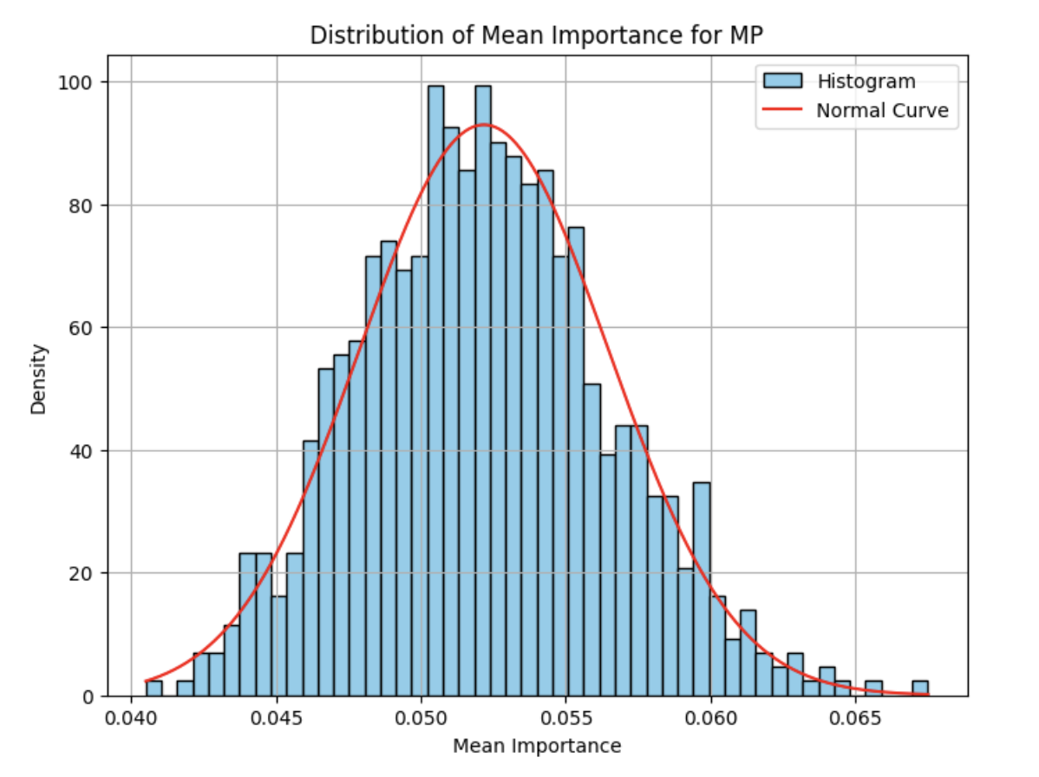
But first: CLT review
The central limit theorem states that as n grows larger, a distribution of sample means of size n will approximate a normal distribution centered at the population mean, regardless of the actual population distribution

Slide 28
Our algorithm
We fitted 800 random forests with different seeds. Each random forest contained 200 decision trees**
For each decision tree, we calculated the importance of each predictor using gini impurity, and took the average importance of each predictor for each forest based on its 200 trees
Thus we had a distribution 800 sample means for the feature importance of each of our predictors
We repeated these steps separately for a dataset from 2004-2008 and a dataset from 2019-2023
**All our decision trees had over 95% testing accuracy, indicating that the feature importance scores they generated are reliable

Slide 29
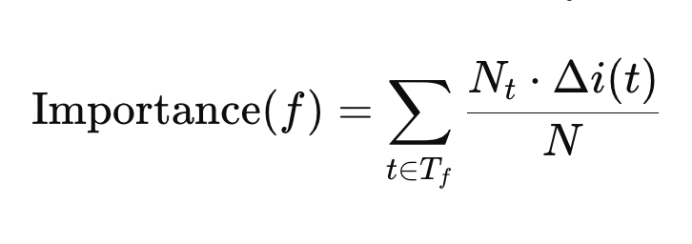
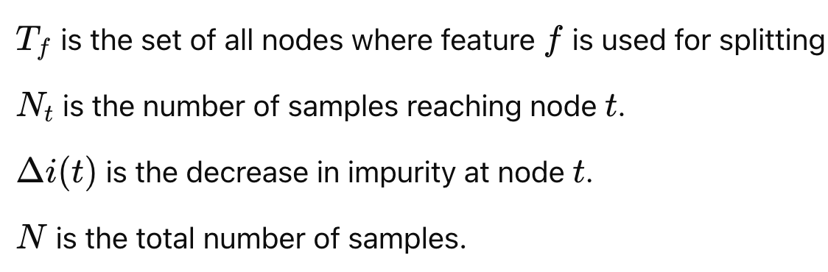
Random forests: extracting feature importance
Gini impurity:
measures the decrease in ambiguity after each node
A smaller gini index means that the amount of uncertainty has gotten smaller at that node(thus indicating that the feature used in that node is more important)
Gini impurity is used to estimate the percent of influence that each feature has on the decision making process
Notes:
Decision trees allow us to see how much influence each predictor has on the final prediction using gini impurity. Gini impurity measures the decrease in ambiguity after each node in which that feature is used to split the data. A smaller gini index represents that the amount of uncertainty in the data has gotten smaller after that node (thus indicating that the feature used in that node is more important)

Slide 30
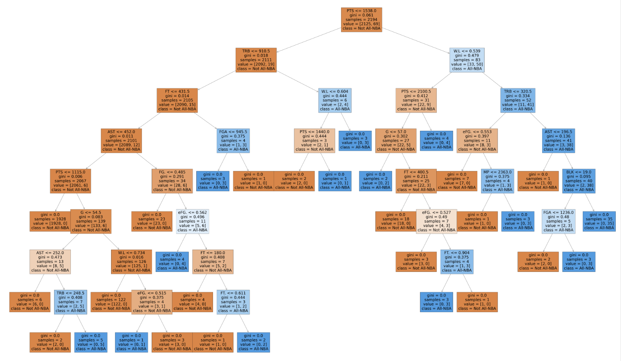

Slide 31
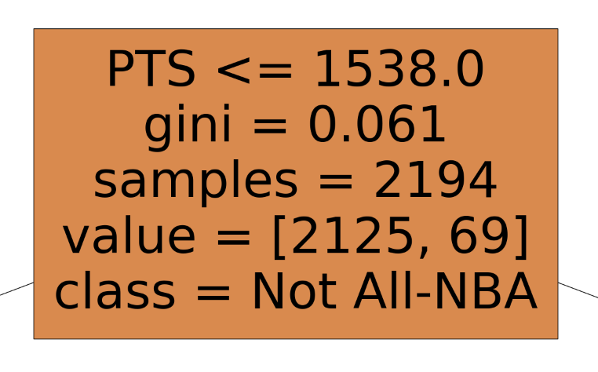
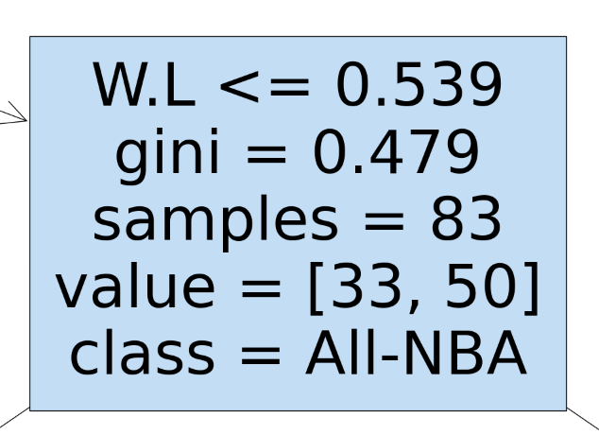
One of our decision trees:
Testing Accuracy: 0.99
This node indicates that if PTS (points) is <= 1538, around 1-.061 = 93.9% of the players beyond this node are Not All-NBA
This node indicates that if W.L (won-loss-percentage) is <= .539, around 1-.479 = 52.1% of the player beyond this node are All-NBA
The lower the gini index, the more information that node gives us. Features used on nodes with lower gini indexes are more important in prediction

Slide 32
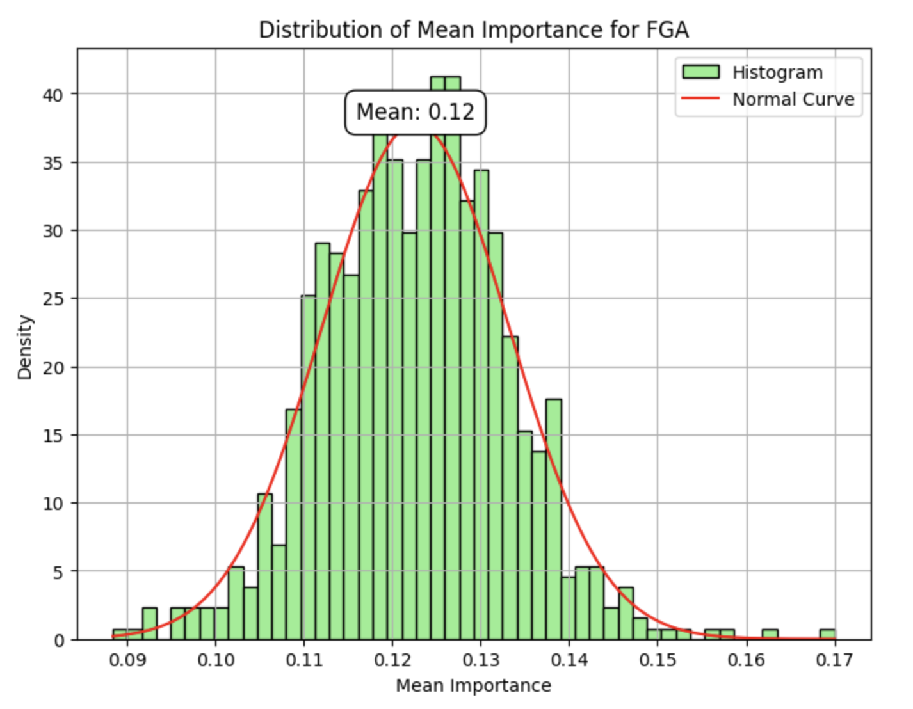
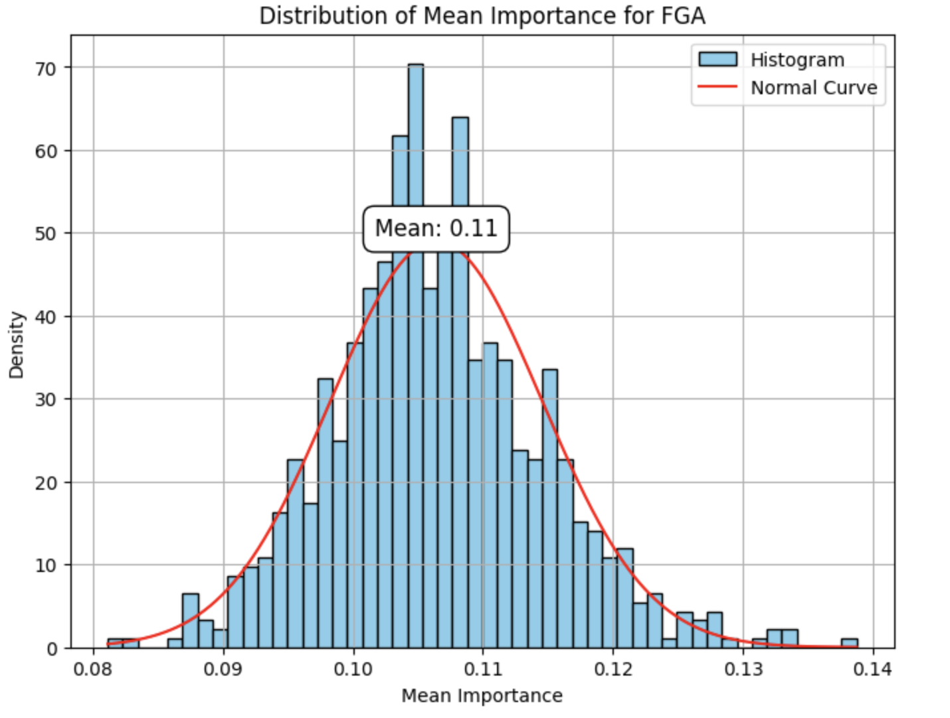
We verified that the distributions of means were approximately normal using histograms
The mean importance of field goals attempted for 2019-2023, centered at ~.12 (FGA contributes about 12% to the final decision-making process for current years )
The mean importance of field goals attempted for 2004-2008, centered at ~.11 (FGA contributes about 11% to the final decision-making process for past years)

Slide 33
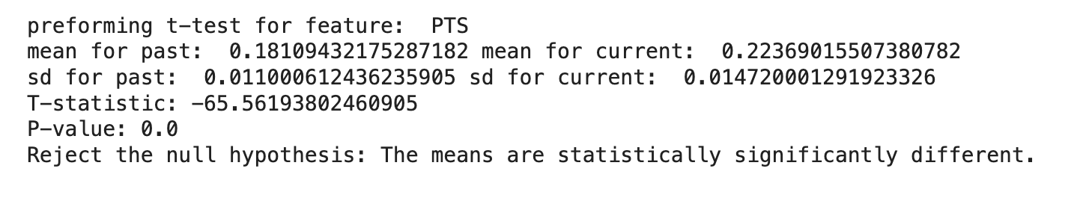
Significance tests
We then used t-tests to see if the differences in feature-importance estimations between time periods were significant enough to conclude whether the importance of each metric in predicting if a player made All-NBA had changed over time
* Note: At n = 800, the sd is so small that our t-tests essentially reduce to comparing the means, which are approximately equal to the population mean based on the CLT. The degrees of freedom are also so large that the t-test reduces to a z test. T-test was chosen for its convenient use in Python and statistical robustness

Slide 34
Significance tests: Results
All the predictors showed statistically significant differences in the means, indicating that the amount of importance each of the metrics has on whether a player is selected for All-NBA has changed in the past decade.

Slide 35
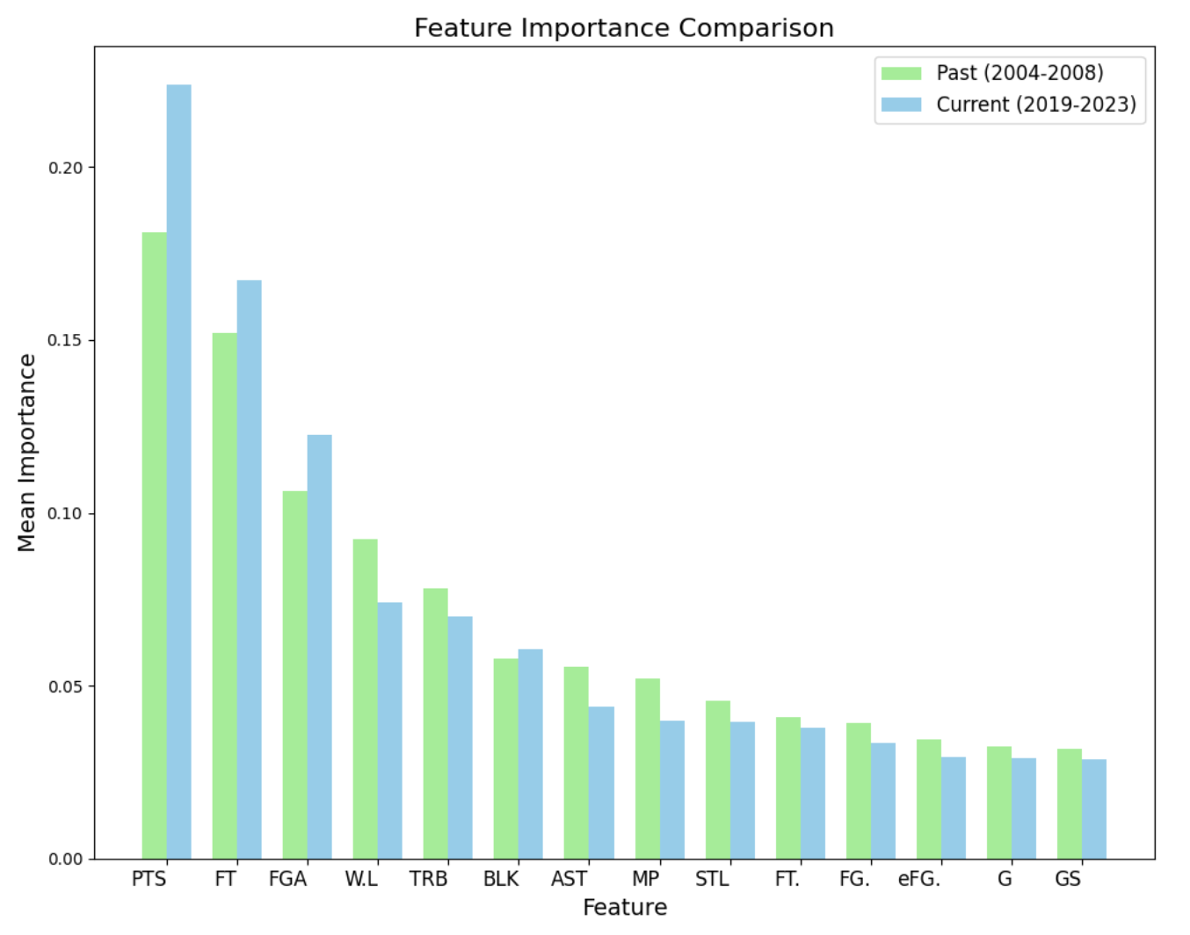
The biggest changes
The amount of points a player scores is a more important predictor of whether they will make All NBA now than in past years

Slide 36
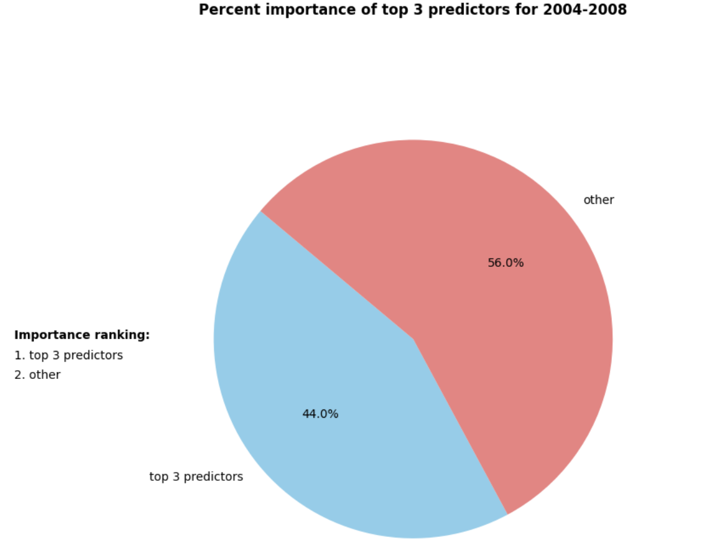
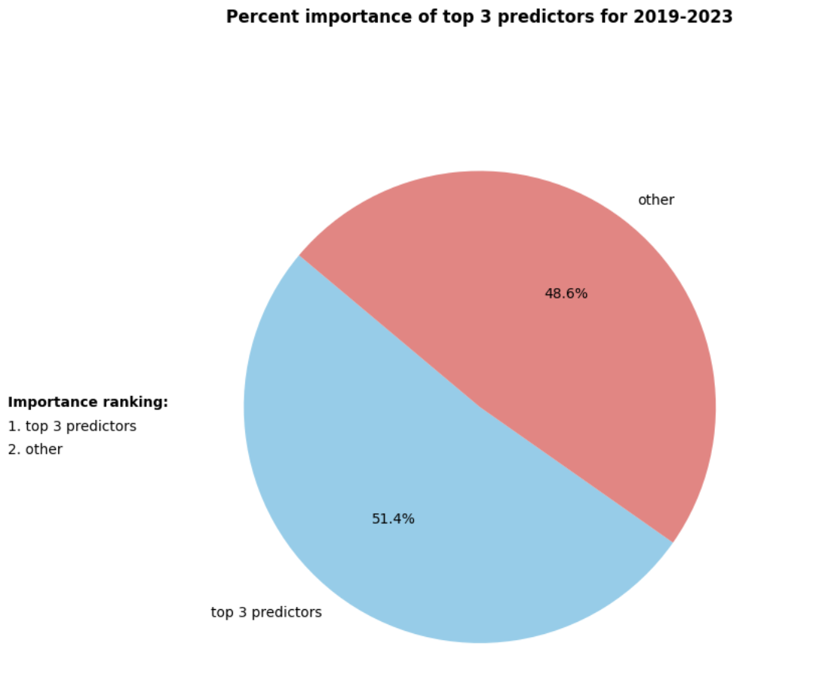
The biggest changes
The decision is also more influenced by the top 3 metrics now than it was in the past. This indicates that the NBA is less interested in well rounded players and more interested in players that score high in fewer, more important metrics

Slide 37
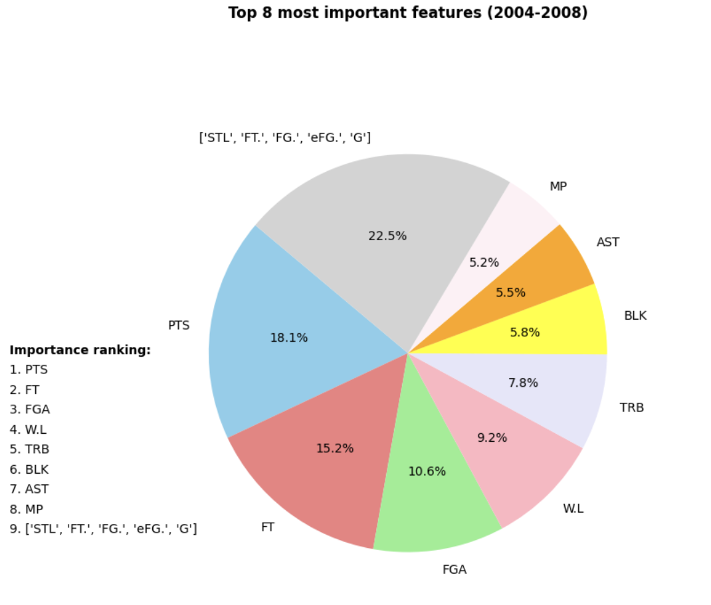
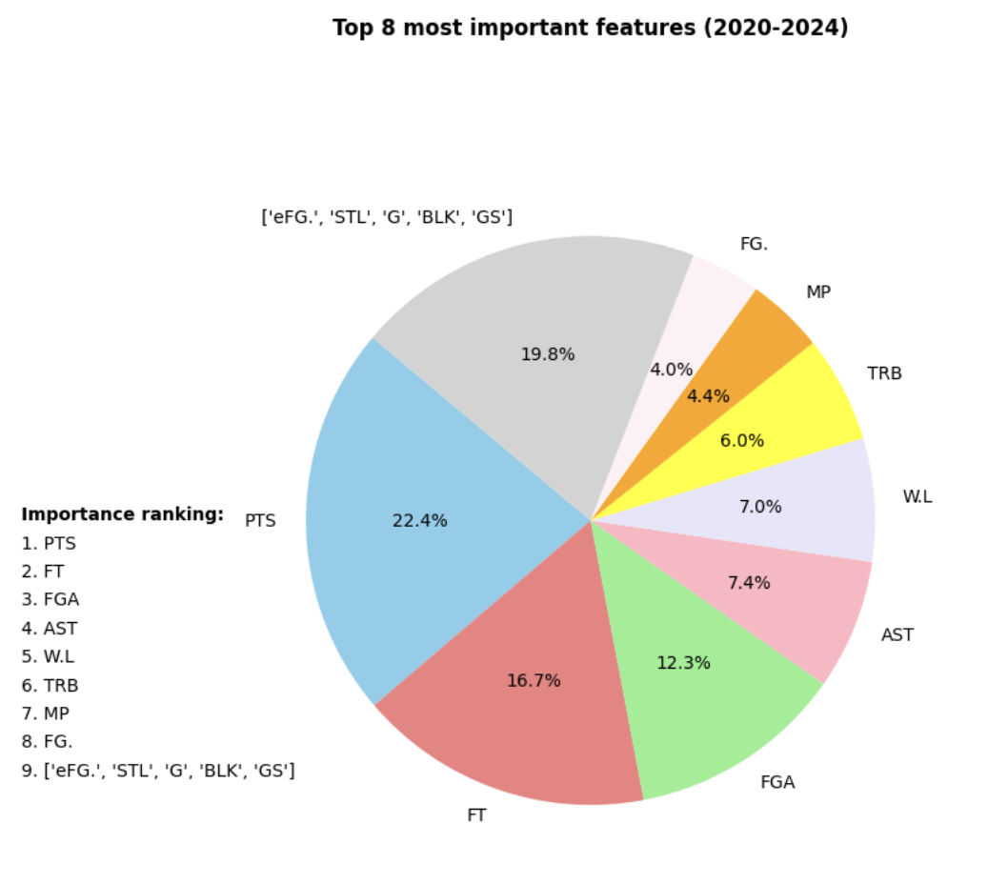
The biggest changes
Some of the top predictors have also changed. In the past, wins-loss percentage (W.L) was the 4th most important predictor, contributing 9% to the final decision.
Now it is the 5th most important predictor behind total rebound and contributes only 7% to the final decision.

Slide 38
Goal 3: Investigate if players who get “snubbed” can be classified
We did this by checking if players selected into All NBA teams can be classified into clusters that could meaningfully identified.
Since K-means clustering requires predetermining the number of clusters and we do not know what the possible clusters may be, we used a hierarchical clustering dendrogram to spot clusters of All NBA players.
Using the variables that were found to be more significant in the previous 4 years, we constructed a clustering of the players who started more games and scored more points than the majority of the nba

Slide 39
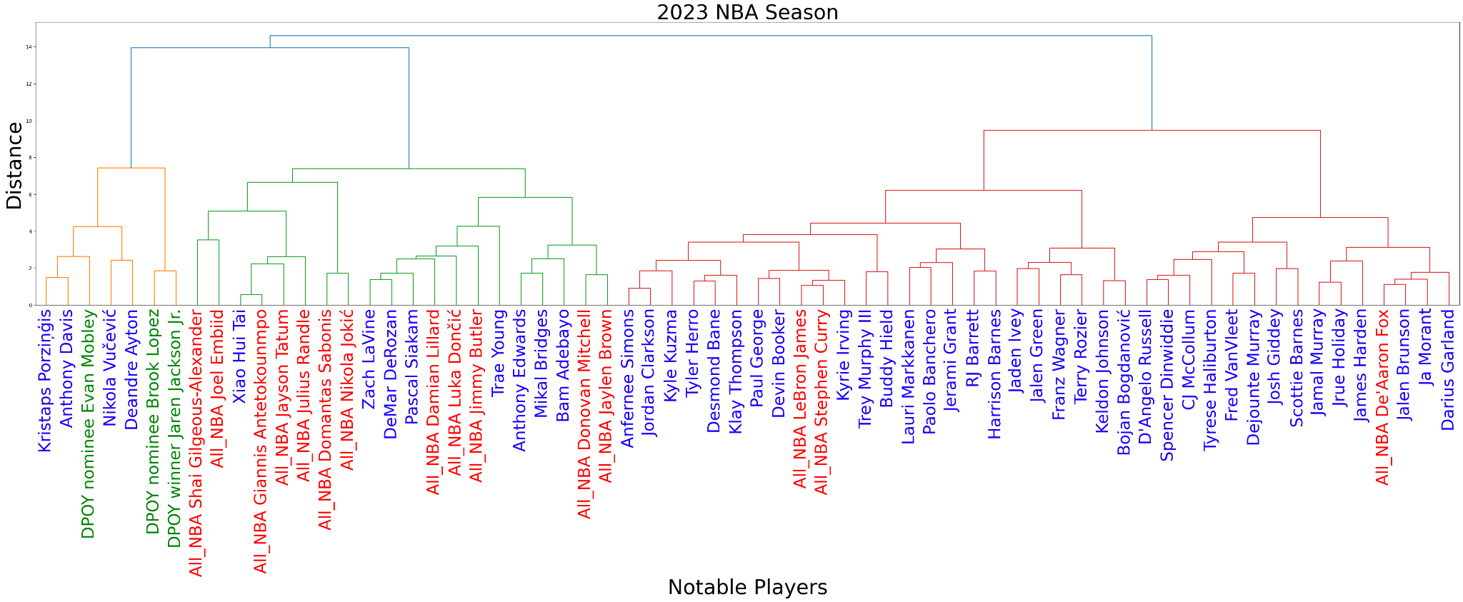
Hierarchical Clustering Dendrogram

Slide 40
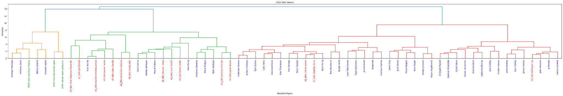
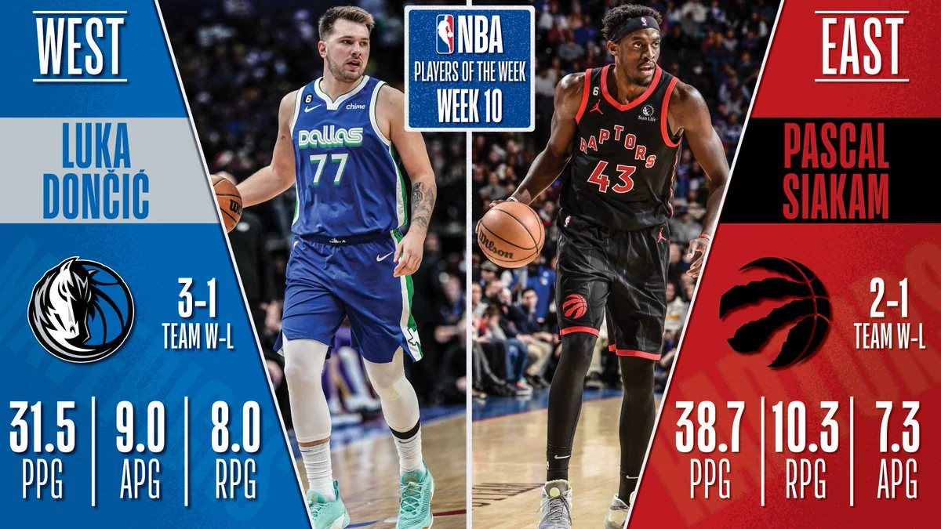
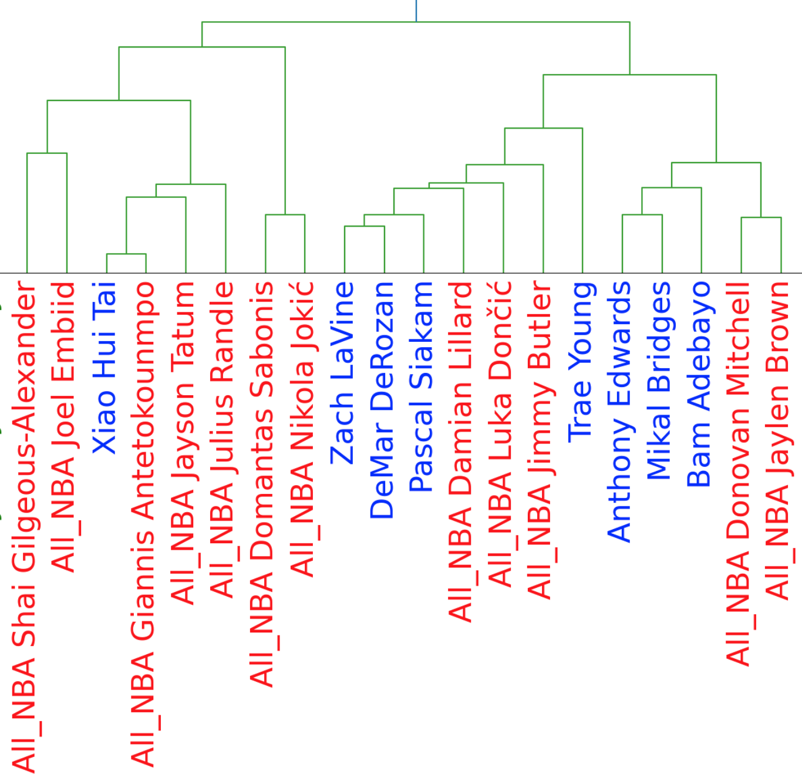
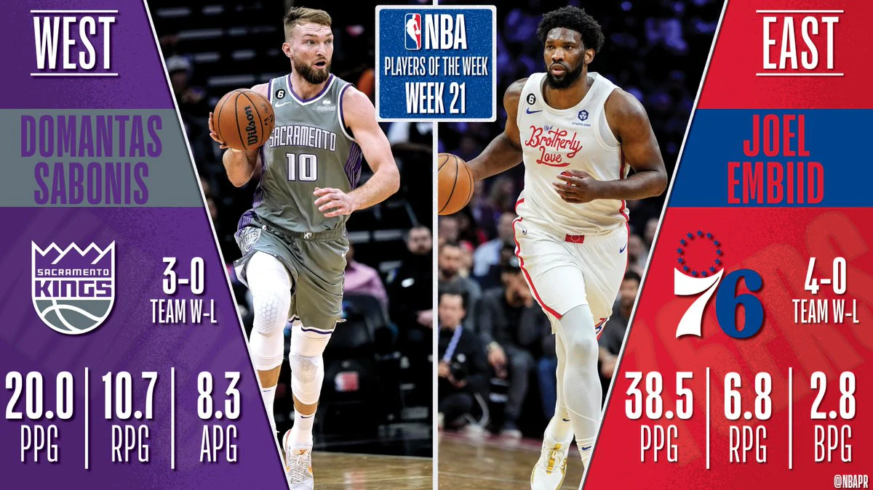
Offensive Cluster
Power Forward and Center sub-cluster
Point Guard and Shooting sub-cluster

Slide 41

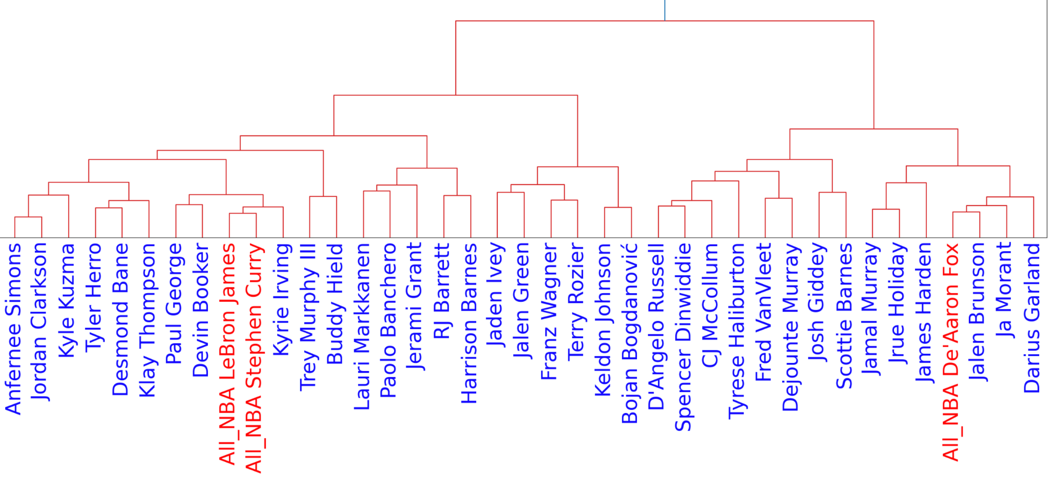
Miscellaneous Cluster
Remaining Players Sub-Cluster
Point Guard and Shooting Guard Sub-Cluster

Slide 42

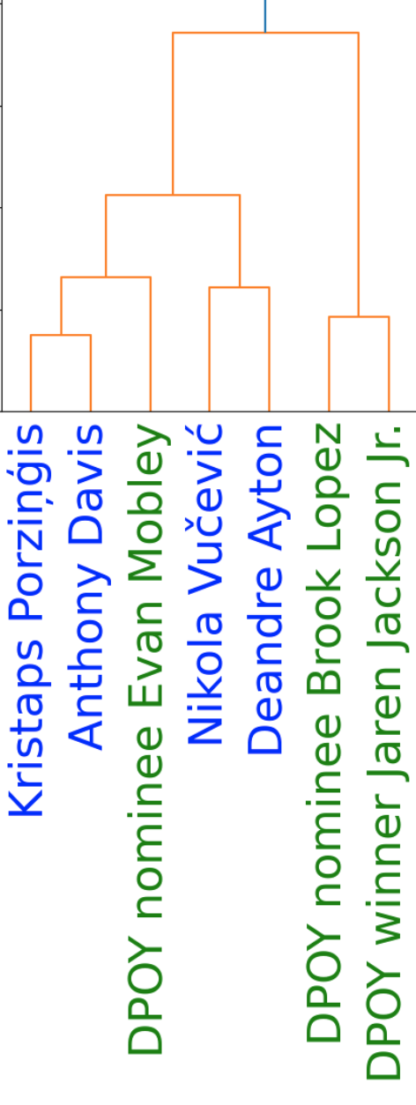
Defensive Power Forward and Center Cluster

Slide 43
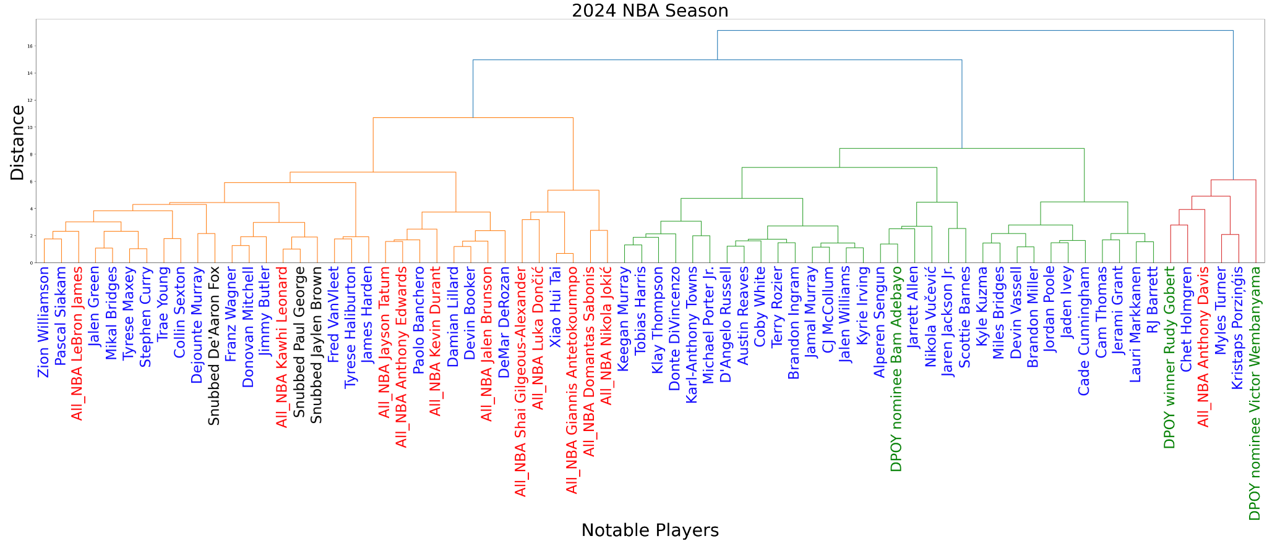
Players most likely to get snubbed

Slide 44
Discussion: Strengths and Limitations
Logistic Regression:
Strengths: simple model
Limitations: may not be able to predict complex relationships between variables
Random Forests:
Strengths: great at finding complex relationships
Limitations: complexity may harm interpretability.
Hierarchical Clustering:
Strengths: very easy to visualize in a dendrogram and does not require cluster
Limitations: sensitive to outliers and noise
Notes:
Logistic regression limitation: this could be a reason why Stephen Curry with a probability of .06 and Tyrese Haliburton with a probability of .02
Random forest limitations: However, we were able to clearly identify significant features via charts.

Slide 45
Discussion: Improvements/Future Work
Logistic Regression:
Evaluate a wider range of training cutoffs rather than just 2, 4, and 8
Random Forests:
Refit a random forest for each year
Hierarchical Clustering:
Eliminate noisy and outlier data
Future Work:
Expand the dataset to contain data from more seasons.
Incorporate more factors (i.e. player +/-, defensive metrics, etc.)
Qualitative sentiment analysis to include cultural aspects
Notes:
so we can see when the changes we noted took place, whether they were gradual or sudden, etc
Qualitative sentiment analysis from tweets about All-NBA and interviews

Slide 46
Conclusion
Goals and Results:
Create model for predicting All-NBA Selections
Logistic Regression correctly predicted ~12/15 All-NBA Players per year
Explore how All-NBA Voting has changed over time
Random Forests to find that points metric and top 3 predictors are more important in recent years and the most important feature rankings have changed
Identify players who were “snubbed”
Hierarchical Clustering with offensive, defensive, and miscellaneous clusters shows that defensive players are more likely to be “snubbed”
Notes:
In summary, our group discovered answers for three different goals and have used unique models for each

Slide 47
Thank you for listening!

